Slide 1
Machine Learning Project 2: Fraud Detection
Seifeldin Tarek
Ahmed Ramy
Omar Ahmed
Ahmed Mahmoud

Slide 2

Problem Overview
• Medicare loses billions yearly due to undetected fraud.
• Manual investigation cannot scale.
• ML helps prioritize high‑risk providers.
• Goal: Reduce loss + improve investigation efficiency.

Slide 3
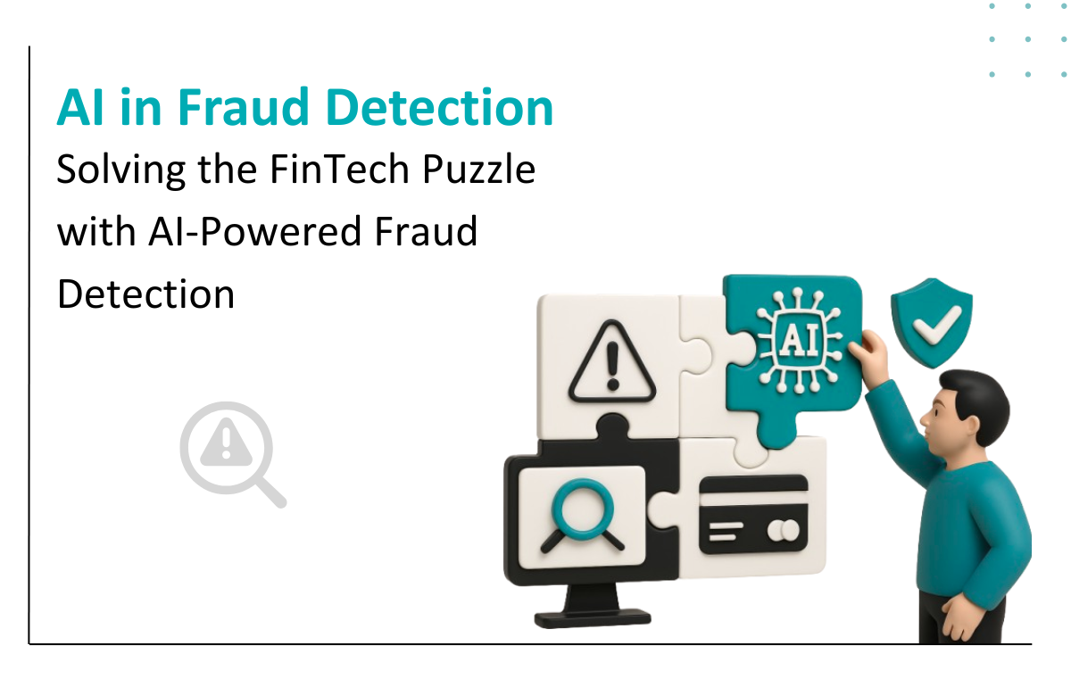
Fraud Detection Pipeline
Raw Claims
Provider Aggregation
Feature Engineering
Model
Fraud Risk Output

Slide 4
Dataset & Preparation
• Combined beneficiary, inpatient, outpatient claims.
• Aggregated into provider-level dataset.
• Cleaned missing values & removed leakage.
• Target: Fraud (binary).
Top Predictors:
  Financial: TotalReimbursement (Fraudsters bill significantly higher amounts).
  Patient Health: ChronicCond_KidneyDisease (Fraudsters often target vulnerable patients with complex needs).

Slide 5
Methodology Flowchart
60% Train
20% Validation
20% Test
Class Weighting
Model Comparison

Slide 6
Models Compared
Logistic Regression (Final Model)
Random Forest
Gradient Boosting
Logistic Regression performed best based on validation Recall & PR‑AUC.

Slide 7
Final Evaluation Results
• Precision: 0.95
• Recall: 1.00
• F1: 0.98
• ROC‑AUC: 1.00
• PR‑AUC: 1.00
High Recall (1.0) -> catches all known fraud cases in the test set

Slide 8
Business Impact
• Detects high‑risk providers early.
• Reduces Medicare financial losses.
• Minimizes unnecessary investigations.
• Provides interpretable, reliable risk scoring.

Slide 9
Conclusion
• Logistic Regression gave best balanced results.
• Strong recall with stable performance.
• Clean, interpretable fraud detection pipeline.
• Ready for extension with more features & models.

Slide 10
Any Questions?
Thank you!

